Slide 1






The big screen theory
?
5000 movies

Slide 2
Feature engineering
Currency exchange and inflation compensation
Cast gender analysis
Movie genre analysis
Blockbusters
Foreign currency to USD
Director’s gender
Inflation
Top 5 genres – Drama, comedy, thriller, action, romance
Actors gender
By first name
High profit
High budget/gross ratio

Slide 3
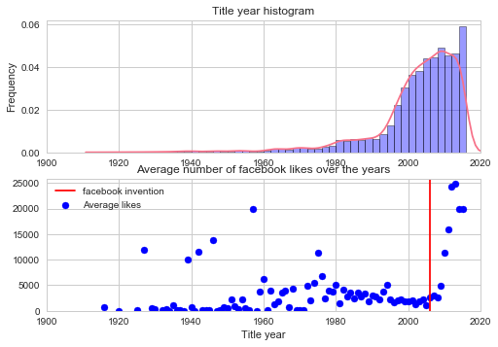
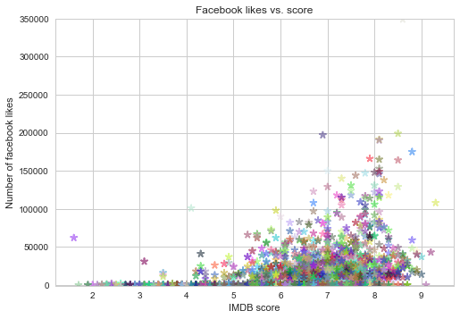
Exploring the data
Facebook likes over the years
Likes vs. score

Slide 4
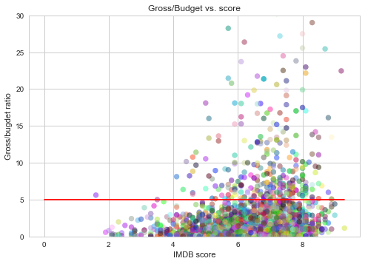
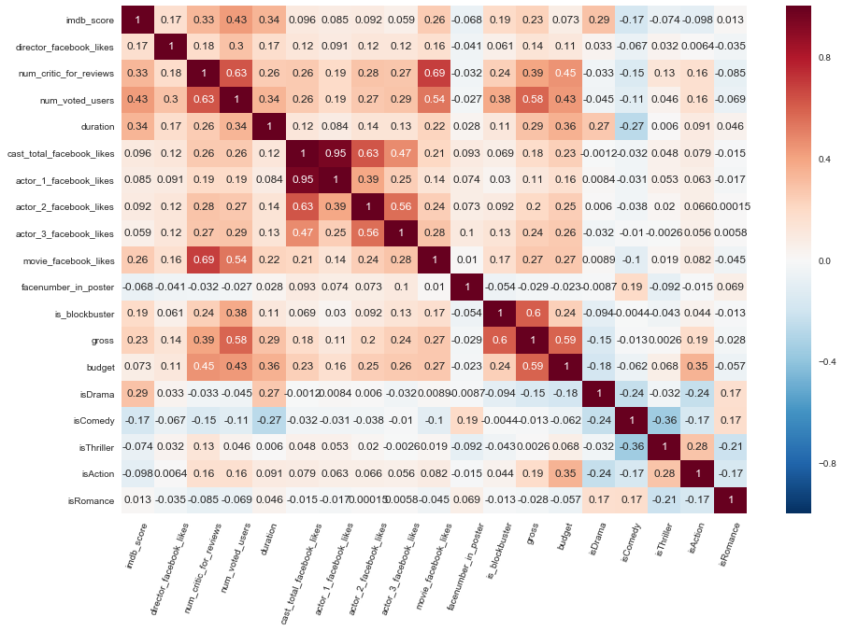
Exploring the data
Profitability vs. score
Feature correlation map

Slide 5
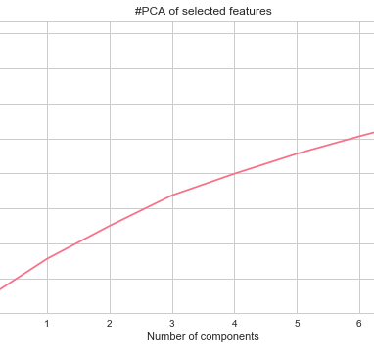
Final analysis
Dimensionality reduction to principle components

